Slide 1
Archeal cell membrane

Slide 2
Characteristics
Chirality of glycerol : While bacteria and eukaryotes have D-glycerol in their membranes, archaeans have L-glycerol in theirs.
Ether linkage : When side chains are added to the glycerol, most organisms bind them together using an ester linkage (see diagram above). The side chain that is added has two oxygen atoms attched to one end. One of these oxygen atoms is used to form the link with the glycerol, and the other protrudes to the side when the bonding is done. By contrast, archaeal side chains are bound using an ether linkage, which lacks that additional protruding oxygen atom. This gives the resulting phospholipid different chemical proerties from the membrane lipids of other organisms.

Slide 3
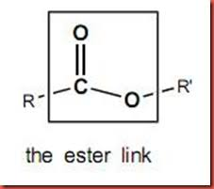
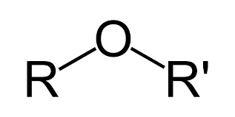
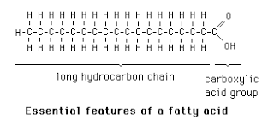
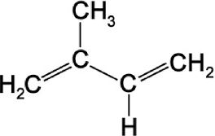
Ether linkage
Isoprene unit

Slide 4
Isoprenoid chains : The side chains in the phospholipids of bacteria and eukaryotes are fatty acids, chains of usually 16 to 18 carbon atoms. Archaea do not use fatty acids to build their membrane phospholipids. Instead, they have side chains of 20 carbon atoms built from isoprene.
Branching of side chains : Not only are the side chains of archaeal membranes built from different components, but the chains themselves have a different physical structure. Because isoprene is used to build the side chains, there are side branches off the main chain

Slide 5
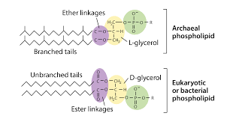

Slide 6
In some archaea, the lipid bilayer is replaced by a monolayer. In effect, the archaea fuse the tails of two phospholipid molecules into a single molecule with two polar heads, this fusion may make their membranes more rigid and better able to resist harsh environments.

